Slide 1
Computer Organization
Part 04: Designing for performance

Slide 2
Basic Terminologies
Processor Clock (P)
Clock rate R = 1/P [Cycles per second]
Electrical unit of CPS is hertz.
Machine language instructions: N.
Average no. of steps for one instr. Cycle: S

Slide 3
Basic Performance Equation
T =
When the instruction execution time is measured in terms of (Cycles per instructions) CPI
N × S
R
N × CPI
R

Slide 4
Basic Performance Equation
T =
p = number of processor cycles required.
m = number of memory references needed.
k = ration between memory cycle and processor cycle.
N × (p+m ×k)
R

Slide 5

System Attributes | Performance Parameters
 | Machine instruction count (N) | Average cycles per instruction |  |  | Clock rate (R)
 |  | Processor Cycles per instruction (p) | Memory references per instruction (m) | Memory access latency (k)
Instruction set architecture
Compiler technology
Processor implementation and control
Cache and memory hierarchy

Slide 6
Processor Speed
Branch prediction
Data flow analysis
Speculative execution
Memory speed
I/O Handling

Slide 7
Moore s Law
Moore observed that the number of transistors that could be put on a single chip was doubling every year and correctly predicted that this pace would continue into the near future. To the surprise of many, including Moore, the pace continued year after year and decade after decade. The pace slowed to a doubling every 18 months in the 1970s but has sustained that rate ever since.

Slide 8
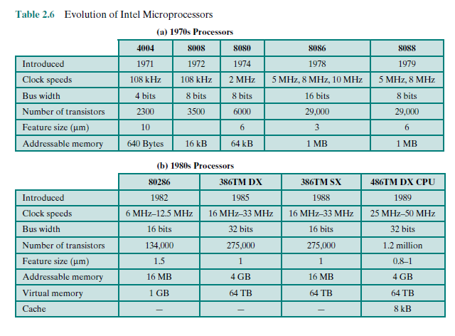

Slide 9
